Slide 2

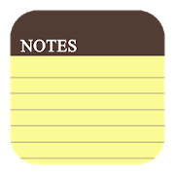
Learning objectives
In this lesson you will learn to:
  use repetition (condition-controlled loops) in algorithms
  use repetition (condition-controlled loops) in code
  use repetition (condition-controlled loops) in flowcharts.
© Pearson Education Ltd 2020. Copying permitted for purchasing institution only.
Notes:
Specification content: 1.2.1 6.1.3 6.2.2 6.5.2 6.5.3

Slide 3
Programming structures
Previously you have learned about sequence and selection.
Remember that sequence is the order in which steps are carried out – one after another.
Selection is about making decisions. Using selection a program chooses a path through an algorithm based on certain conditions.
Looping is a way of executing parts of a program over and over again, without rewriting the code. It can be used to repeatedly execute code.
© Pearson Education Ltd 2020. Copying permitted for purchasing institution only.

Slide 4
Going loopy
Sometimes, you really do need to repeat yourself.
In programming it is often necessary to repeat steps a certain number of times or until a condition is met.
There are two types of repeat loops: condition-controlled and count-controlled.
You are going to focus on condition-controlled loops today.
© Pearson Education Ltd 2020. Copying permitted for purchasing institution only.
Notes:
Pi, gravity, VAT

Slide 5
Condition-controlled loops
A condition-controlled loop is a structure that allows a block of steps in code to be repeated while a condition is true.
These conditions are the same as the types we looked at in selection.
Let’s look at an example to see why this is so useful.
© Pearson Education Ltd 2020. Copying permitted for purchasing institution only.

Slide 6
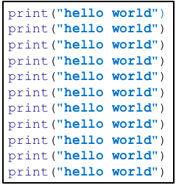
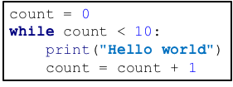
Example
Let’s imagine you wanted to print ‘hello world’ ten times.
You could do it like this:
But this would be time consuming and inefficient.
Instead you could use a while loop like this:
© Pearson Education Ltd 2020. Copying permitted for purchasing institution only.

Slide 7
In detail
2. ‘While’ keyword with a condition - controls the loop.
This reads ‘while the value in the variable count is less than 10…’
1. create variable that counts how many times the code has looped.
count = 0
while count < 10:
print("Hello world")
count = count + 1
Notice the colon – just as in ‘if’ statements.
Lines are indented. They happen inside the loop. They will be repeated over and over.
This line adds one to the counter, showing a pass through the loop has been completed.
© Pearson Education Ltd 2020. Copying permitted for purchasing institution only.
Notes:
Student Activity 1

Slide 8
However…
There’s much more to repetition than just counting.
You can use a condition-controlled loop to wait for the user to type something in, for example a ‘Q’ to quit a program.
Let’s look at another example.
© Pearson Education Ltd 2020. Copying permitted for purchasing institution only.

Slide 9
Getting input
Imagine you are building a small part of a larger program.
You want your program to keep asking the user for an input until they type ‘exit’.
The input could be used for something else later on, but for now it will just be printed out.
userChoice = ""
while userChoice != "exit":
userChoice = input("Enter your choice: ")
print("You chose:", userChoice)
Declare and initialise a variable to store the user’s choice.
Create a while loop that looks at what the user entered to see if it is ‘exit’.
If it’s not ‘exit’ ask the user to enter something.
Print what the user entered.
Loop back to Step 3.
© Pearson Education Ltd 2020. Copying permitted for purchasing institution only.
Notes:
Student Activity 2

Slide 10
In a flowchart
There are no ‘while’ or ‘loop’ symbols in flowcharts.
How do you think you might implement a loop using a flowchart?
You have already learned how condition statements are used to control program flow in if statements.
Where in a flowchart is a condition tested?
weather == “rain”?
No
        In a decision
Yes
output “take an umbrella”
output “no need for the umbrella today”
© Pearson Education Ltd 2020. Copying permitted for purchasing institution only.

Slide 11
In a flowchart
start
Let’s use our userChoice example to see how a while loop works in a flowchart.
userChoice = “”
userChoice != “exit”?
No
userChoice = ""
while userChoice != "exit":
userChoice = input("Enter your choice: ")
print("You chose:", userChoice)
Yes
userChoice = user input
output userChoice
This is the ‘loop’.
It takes the program back to the condition.
end
© Pearson Education Ltd 2020. Copying permitted for purchasing institution only.
Notes:
Student Activity 3

Slide 12
Nesting
It is common for programmers to need to put one piece of complex code within another piece of code.
This is known as nesting – when one programming structure is put inside another.
This is a very common procedure, so you’ll need to get to grips with how it works.
© Pearson Education Ltd 2020. Copying permitted for purchasing institution only.

Slide 13

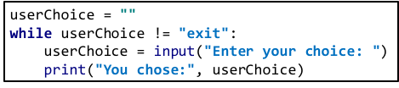
Nesting: an example
Let’s build some functionality into the user choice program.
If the user types in ‘hello’, you want the program to say ‘hello’ back.
Where would you add this ‘if’ statement?
It would have to go inside the while loop.
© Pearson Education Ltd 2020. Copying permitted for purchasing institution only.

Slide 14
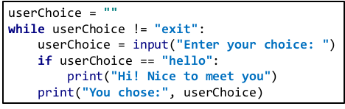
Nesting: an example
The ‘if’ statement has been added so that the program says ‘hello’ back to the user.
Notice that the statement is placed after the line that asks the user to type in their choice. Notice that it is indented to match that line. This puts it inside the loop.
Your next challenge will be to add more selection statements (using ‘elif’ and ‘else’) to provide additional options for the user.
© Pearson Education Ltd 2020. Copying permitted for purchasing institution only.
Notes:
Student Activity 4 (if you have time to give them an extra challenge)

Slide 15
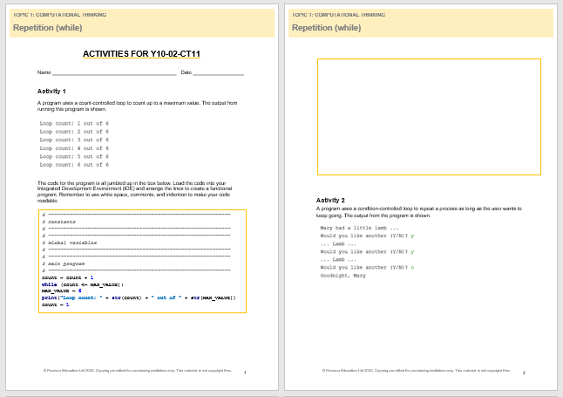
Activity Worksheet make sure that you have written enough of the task so that the answer makes sense in your books.
© Pearson Education Ltd 2020. Copying permitted for purchasing institution only.

Slide 16
Wrap up, you have learned how to . . .
Use condition-controlled loops.
Use while loops in Python to repeat sections of code, saving yourself the trouble of writing them over and over again.
Represent a while loop using the decision symbol in a flowchart.
Nest code – putting structures inside one another.
© Pearson Education Ltd 2020. Copying permitted for purchasing institution only.

